Slide 1
Chapter 1
Computer Abstractions and Technology

Slide 2
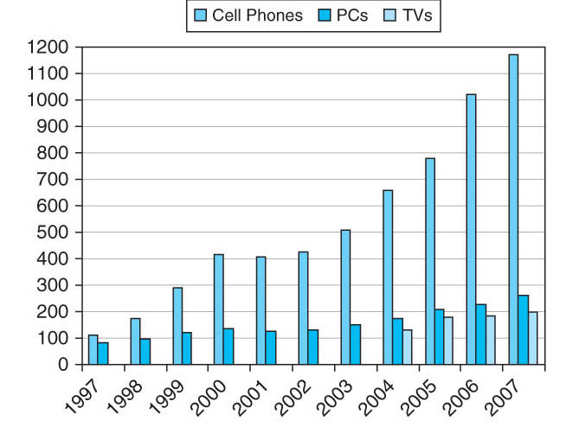
FIGURE 1.1 The number of cell phones, personal computers, and televisions manufactured per year between 1997 and 2007. (We have television data only from 2004.) More than a billion new cell phones were shipped in 2006. Cell phones sales exceeded PCs by only a factor of 1.4 in 1997, but the ratio grew to 4.5 in 2007. The total number in use in 2004 is estimated to be about 2.0B televisions, 1.8B cell phones, and 0.8B PCs. As the world population was about 6.4B in 2004, there were approximately one PC, 2.2 cell phones, and 2.5 televisions for every eight people on the planet. A 2006 survey of U.S. families found that they owned on average 12 gadgets, including three TVs, 2 PCs, and other devices such as game consoles, MP3 players, and cell phones. Copyright © 2009 Elsevier, Inc. All rights reserved.

Slide 3
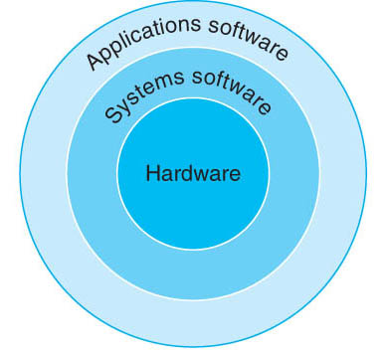
FIGURE 1.2 A simplifi ed view of hardware and software as hierarchical layers, shown as concentric circles with hardware in the center and applications software outermost. In complex applications, there are often multiple layers of application software as well. For example, a database system may run on top of the systems software hosting an application, which in turn runs on top of the database. Copyright © 2009 Elsevier, Inc. All rights reserved.

Slide 4
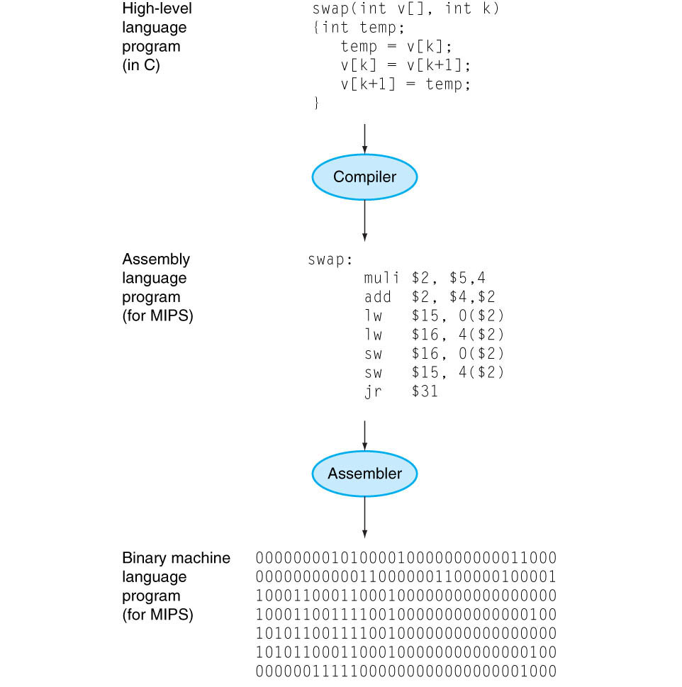
FIGURE 1.3 C program compiled into assembly language and then assembled into binary machine language. Although the translation from high-level language to binary machine language is shown in two steps, some compilers cut out the middleman and produce binary machine language directly. These languages and this program are examined in more detail in Chapter 2. Copyright © 2009 Elsevier, Inc. All rights reserved.

Slide 5
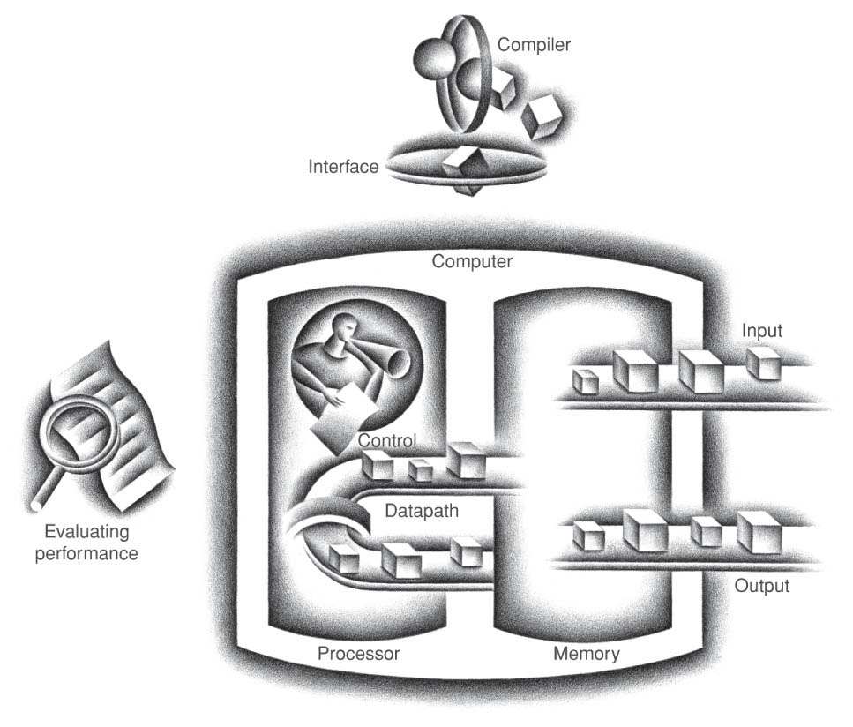
FIGURE 1.4 The organization of a computer, showing the fi ve classic components. The processor gets instructions and data from memory. Input writes data to memory, and output reads data from memory. Control sends the signals that determine the operations of the datapath, memory, input, and output. Copyright © 2009 Elsevier, Inc. All rights reserved.

Slide 6
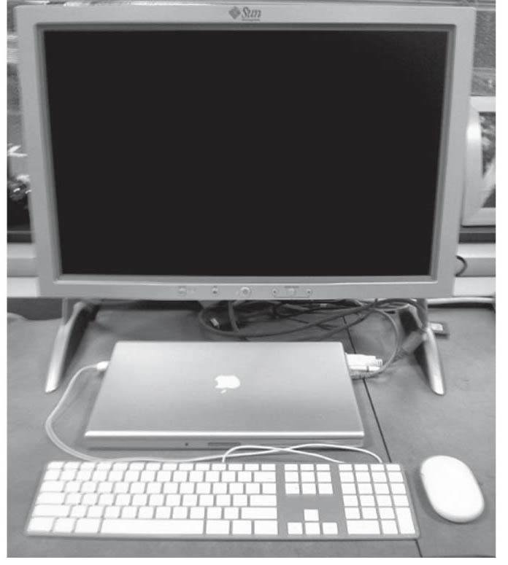
FIGURE 1.5 A desktop computer. The liquid crystal display (LCD) screen is the primary output device, and the keyboard and mouse are the primary input devices. On the right side is an Ethernet cable that connected the laptop to the network and the Web. The lap top contains the processor, memory, and additional I/O devices. This system is a Macbook Pro 15" laptop connected to an external display. Copyright © 2009 Elsevier, Inc. All rights reserved.

Slide 7
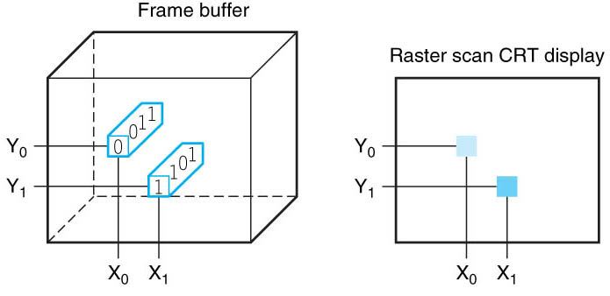
FIGURE 1.6 Each coordinate in the frame buffer on the left determines the shade of the corresponding coordinate for the raster scan CRT display on the right. Pixel (X0, Y0) contains the bit pattern 0011, which is a lighter shade on the screen than the bit pattern 1101 in pixel (X1, Y1). Copyright © 2009 Elsevier, Inc. All rights reserved.

Slide 8
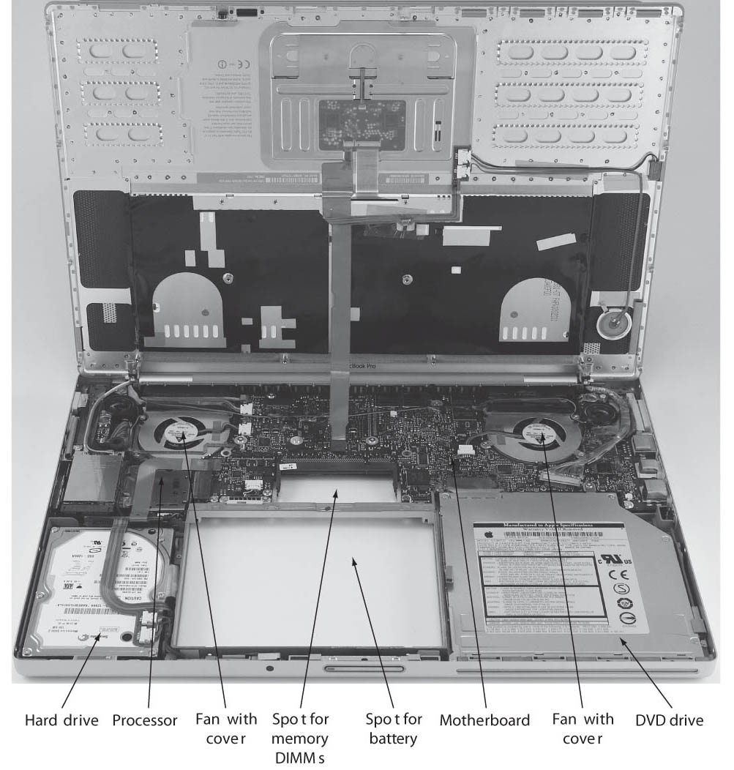
FIGURE 1.7 Inside the laptop computer of Figure 1.5. The shiny box with the white label on the lower left is a 100 GB SATA hard disk drive, and the shiny metal box on the lower right side is the DVD drive. The hole between them is where the laptop battery would be located. The small hole above the battery hole is for memory DIMMs. Figure 1.8 is a close-up of the DIMMs, which are inserted from the bottom in this laptop. Above the battery hole and DVD drive is a printed circuit board (PC board), called the motherboard, which contains most of the electronics of the computer. The two shiny circles in the upper half of the picture are two fans with covers. The processor is the large raised rectangle just below the left fan. Photo courtesy of OtherWorldComputing.com. Copyright © 2009 Elsevier, Inc. All rights reserved.

Slide 9
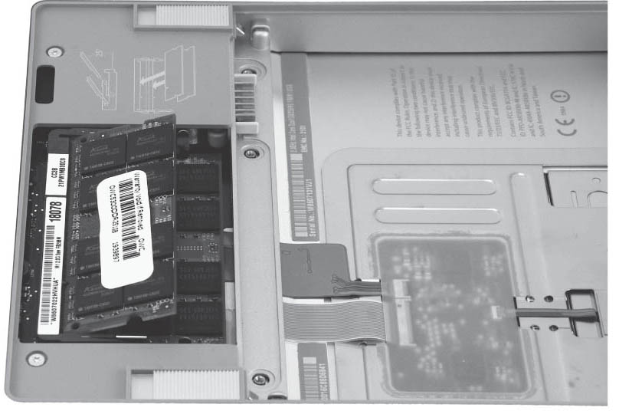
FIGURE 1.8 Close-up of the bottom of the laptop reveals the memory. The main memory is contained on one or more small boards shown on the left. The hole for the battery is to the right. The DRAM chips are mounted on these boards (called DIMMs, for dual inline memory modules) and then plugged into the connectors. Photo courtesy of OtherWorldComputing.com. Copyright © 2009 Elsevier, Inc. All rights reserved.

Slide 10
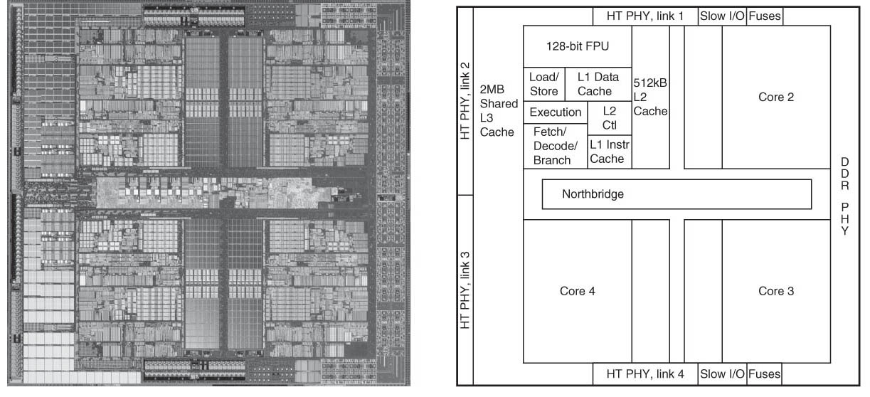
FIGURE 1.9 Inside the AMD Barcelona microprocessor. The left-hand side is a microphotograph of the AMD Barcelona processor chip, and the right-hand side shows the major blocks in the processor. This chip has four processors or “cores”. The microprocessor in the laptop in Figure 1.7 has two cores per chip, called an Intel Core 2 Duo. Copyright © 2009 Elsevier, Inc. All rights reserved.

Slide 11
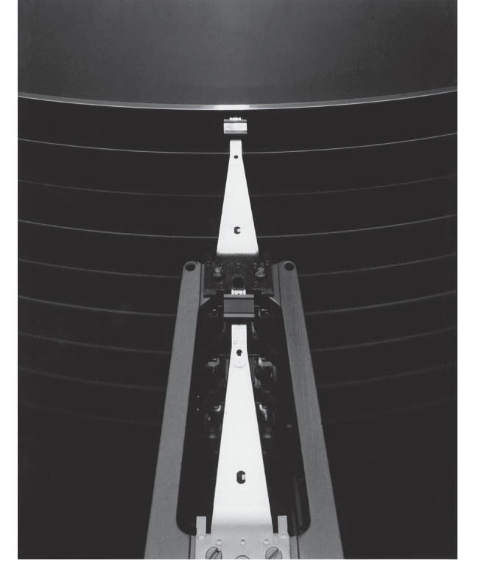
FIGURE 1.10 A disk showing 10 disk platters and the read/write heads. Copyright © 2009 Elsevier, Inc. All rights reserved.

Slide 12
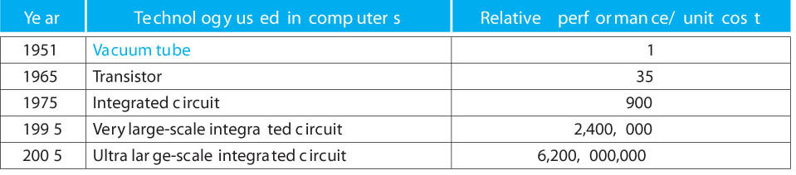
FIGURE 1.11 Relative performance per unit cost of technologies used in computers over time. Source: Computer Museum, Boston, with 2005 extrapolated by the authors. See Section 1.10 on the CD.Copyright © 2009 Elsevier, Inc. All rights reserved.

Slide 13
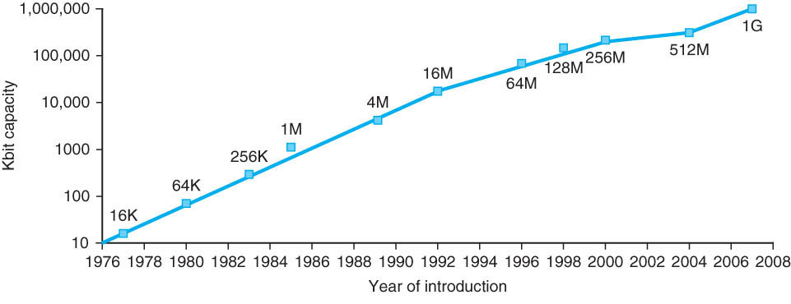
FIGURE 1.12 Growth of capacity per DRAM chip over time. The y-axis is measured in Kilobits, where K = 1024 (210 ). The DRAM industry quadrupled capacity almost every three years, a 60% increase per year, for 20 years. In recent years, the rate has slowed down and is somewhat closer to doubling every two years to three years. Copyright © 2009 Elsevier, Inc. All rights reserved.

Slide 14
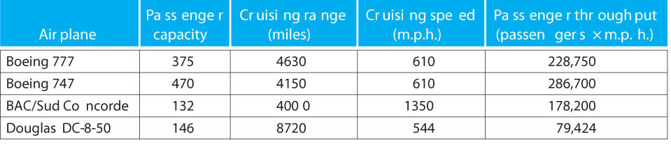
FIGURE 1.13 The capacity, range, and speed for a number of commercial airplanes. The last column shows the rate at which the airplane transports passengers, which is the capacity times the cruising speed (ignoring range and takeoff and landing times). Copyright © 2009 Elsevier, Inc. All rights reserved.

Slide 15
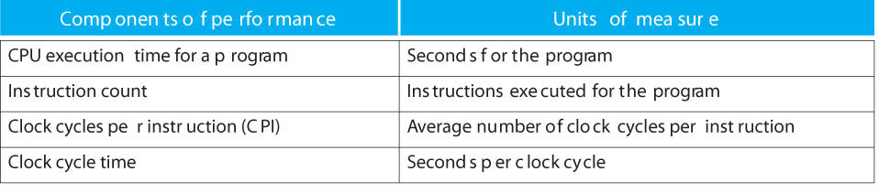
FIGURE 1.14 The basic components of performance and how each is measured. Copyright © 2009 Elsevier, Inc. All rights reserved.

Slide 16
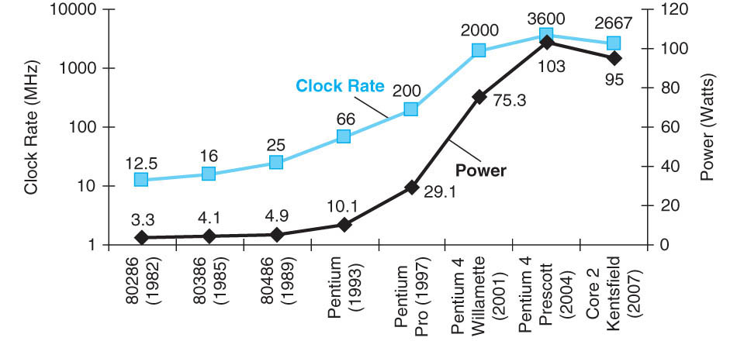
FIGURE 1.15 Clock rate and Power for Intel x86 microprocessors over eight generations and 25 years. The Pentium 4 made a dramatic jump in clock rate and power but less so in performance. The Prescott thermal problems led to the abandonment of the Pentium 4 line. The Core 2 line reverts to a simpler pipeline with lower clock rates and multiple processors per chip. Copyright © 2009 Elsevier, Inc. All rights reserved.

Slide 17
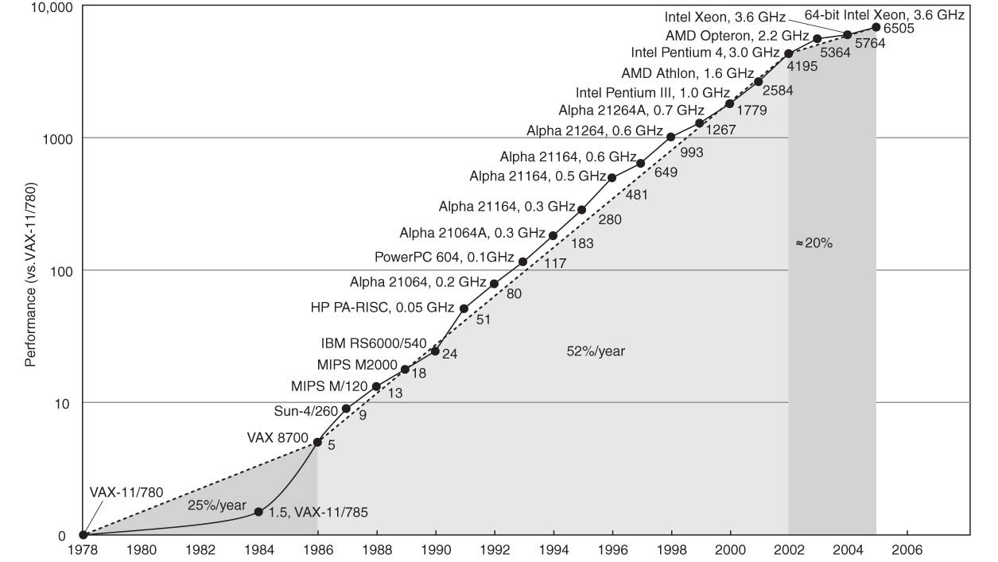
FIGURE 1.16 Growth in processor performance since the mid-1980s. This chart plots performance relative to the VAX 11/780 as measured by the SPECint benchmarks (see Section 1.8). Prior to the mid-1980s, processor performance growth was largely technologydriven and averaged about 25% per year. The increase in growth to about 52% since then is attributable to more advanced architectural and organizational ideas. By 2002, this growth led to a difference in performance of about a factor of seven. Performance for fl oating-pointoriented calculations has increased even faster. Since 2002, the limits of power, available instruction-level parallelism, and long memory latency have slowed uniprocessor performance recently, to about 20% per year. Copyright © 2009 Elsevier, Inc. All rights reserved.

Slide 18
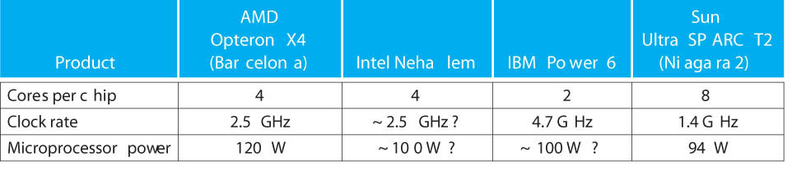
FIGURE 1.17 Number of cores per chip, clock rate, and power for 2008 multicore microprocessors. Copyright © 2009 Elsevier, Inc. All rights reserved.

Slide 19
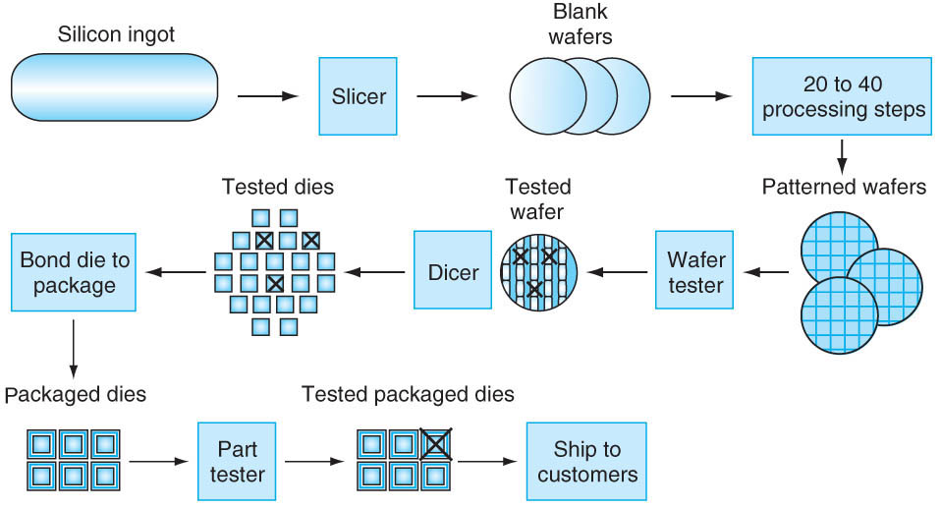
FIGURE 1.18 The chip manufacturing process. After being sliced from the silicon ingot, blank wafers are put through 20 to 40 steps to create patterned wafers (see Figure 1.19). These pat terned wafers are then tested with a wafer tester, and a map of the good parts is made. Then, the wafers are diced into dies (see Figure 1.9). In this fi gure, one wafer produced 20 dies, of which 17 passed testing. (X means the die is bad.) The yield of good dies in this case was 17/20, or 85%. These good dies are then bonded into packages
and tested one more time before shipping the packaged parts to customers. One bad packaged part was found in this fi nal test. Copyright © 2009 Elsevier, Inc. All rights reserved.

Slide 20
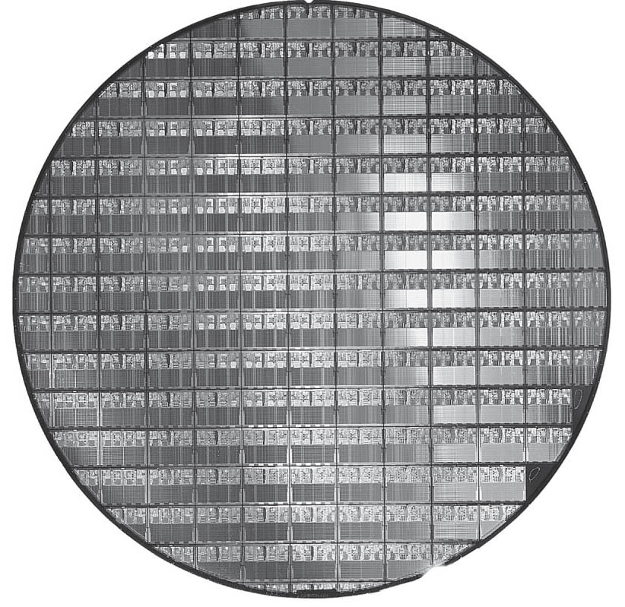
FIGURE 1.19 A 12-inch (300mm) wafer of AMD Opteron X2 chips, the predecessor of Opteron X4 chips (Courtesy AMD). The number of dies per wafer at 100% yield is 117. The several dozen partially rounded chips at the boundaries of the wafer are useless; they are included because it’s easier to create the masks used to pattern the silicon. This die uses a 90-nanometer technology, which means that the smallest transistors are approximately 90 nm in size, although they are typically somewhat smaller than the actual feature size, which refers to the size of the transistors as “drawn” versus the final manufactured size. Copyright © 2009 Elsevier, Inc. All rights reserved.

Slide 21
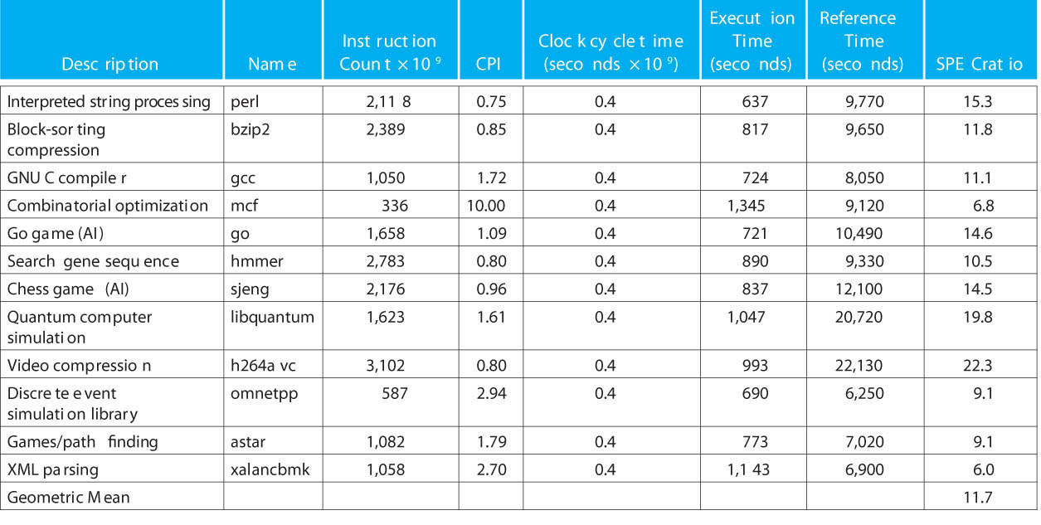
FIGURE 1.20 SPECINTC2006 benchmarks running on AMD Opteron X4 model 2356 (Barcelona). As the equation on page 35 explains, execution time is the prod uct of the three factors in this table: instruction count in billions, clocks per instruction (CPI), and clock cycle time in nanoseconds. SPECratio is sim ply the reference time, which is supplied by SPEC, divided by the measured execution time. The single number quoted as SPECINTC2006 is the geometric mean of the SPECratios. Figure 5.40 on page 542 shows that mcf, libquantum, omnetpp, and xalancbmk have relatively high CPIs because they have high cache miss rates. Copyright © 2009 Elsevier, Inc. All rights reserved.

Slide 22
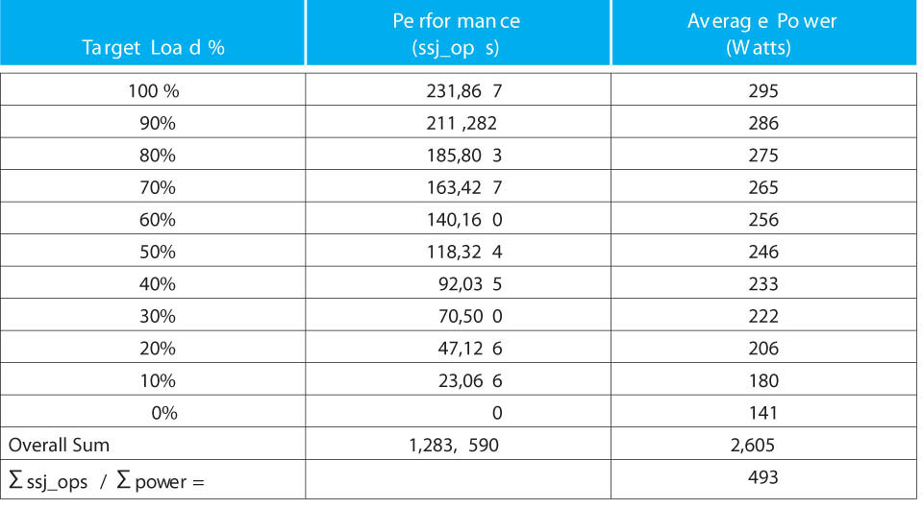
FIGURE 1.21 SPECpower_ssj2008 running on dual socket 2.3 GHz AMD Opteron X4 2356 (Barcelona) with 16 GB Of DDR2-667 DRAM and one 500 GB disk. Copyright © 2009 Elsevier, Inc. All rights reserved.

Slide 23
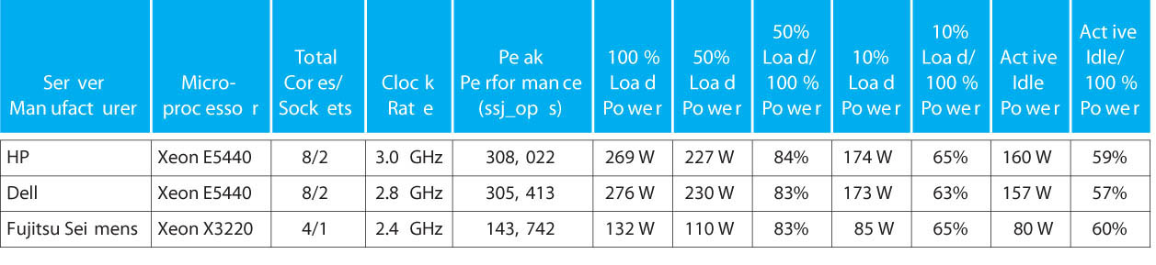
FIGURE 1.22 SPECPower results for three servers with the best overall ssj_ops per watt in the fourth quarter of 2007. The overall ssj_ops per watt of the three servers are 698, 682, and 667, respectively. The memory of the top two servers is 16 GB and the bottom is 8 GB. Copyright © 2009 Elsevier, Inc. All rights reserved.

